Slide 1
CS50P FINAL PROJECT
01
PromptVault
A local command-line library for better prompts.
PROMPT
VAULT
Student: Veselin GitHub: github.com/veselinkalinov edX: vesko_kalinov06 Location: Varna, Bulgaria Recorded: 20 July 2026
LOCAL JSON
Store • Analyze • Improve

Slide 2
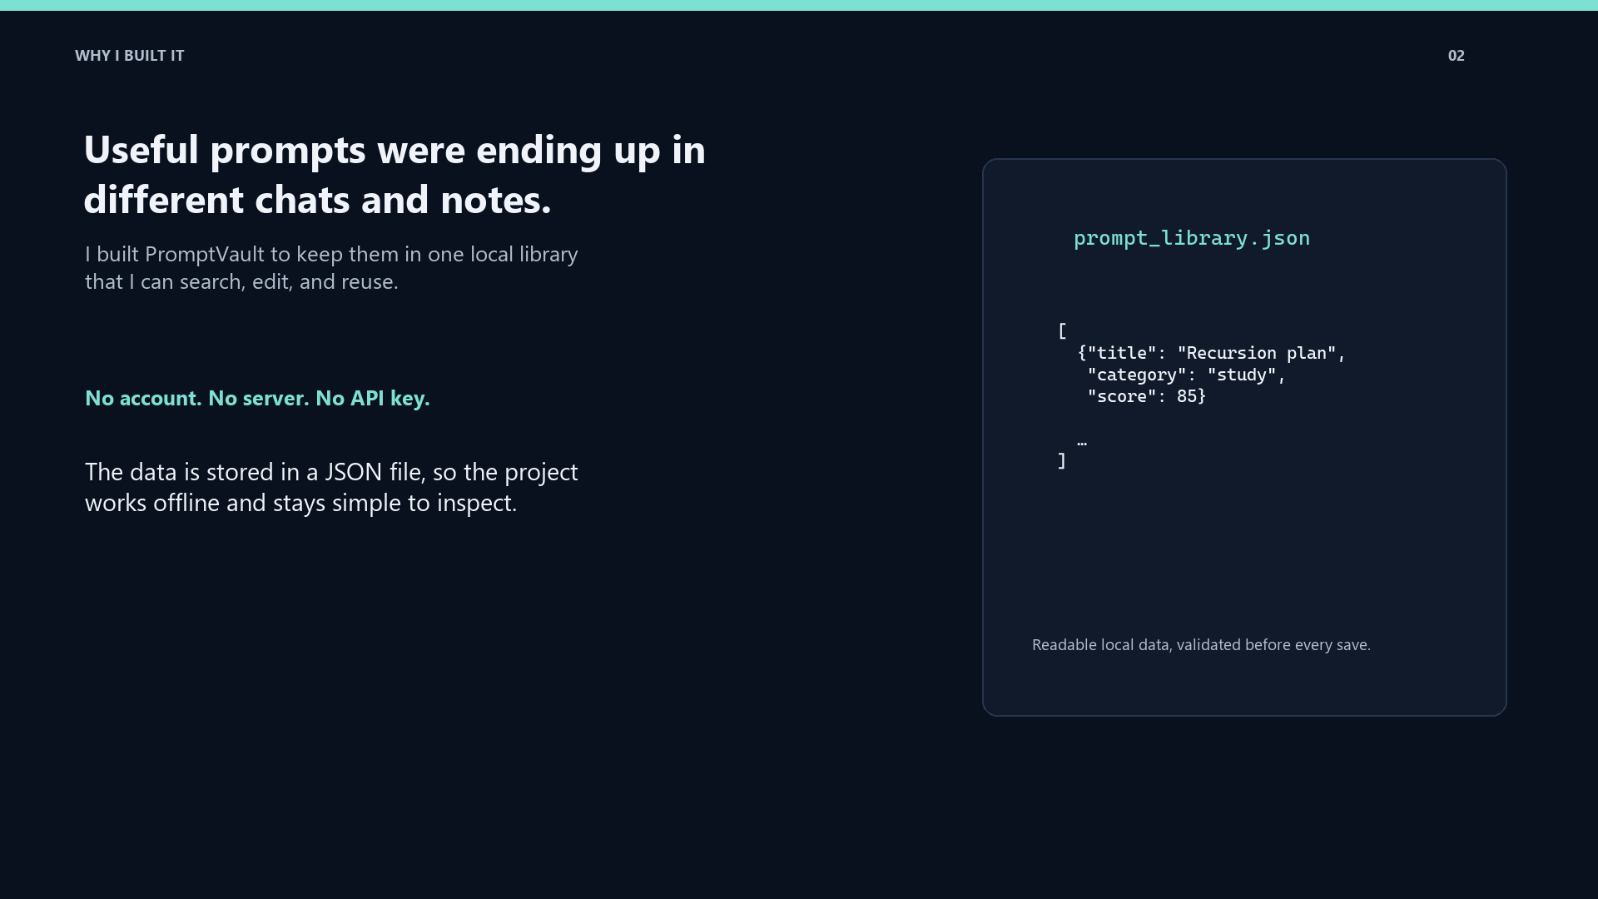

Slide 3
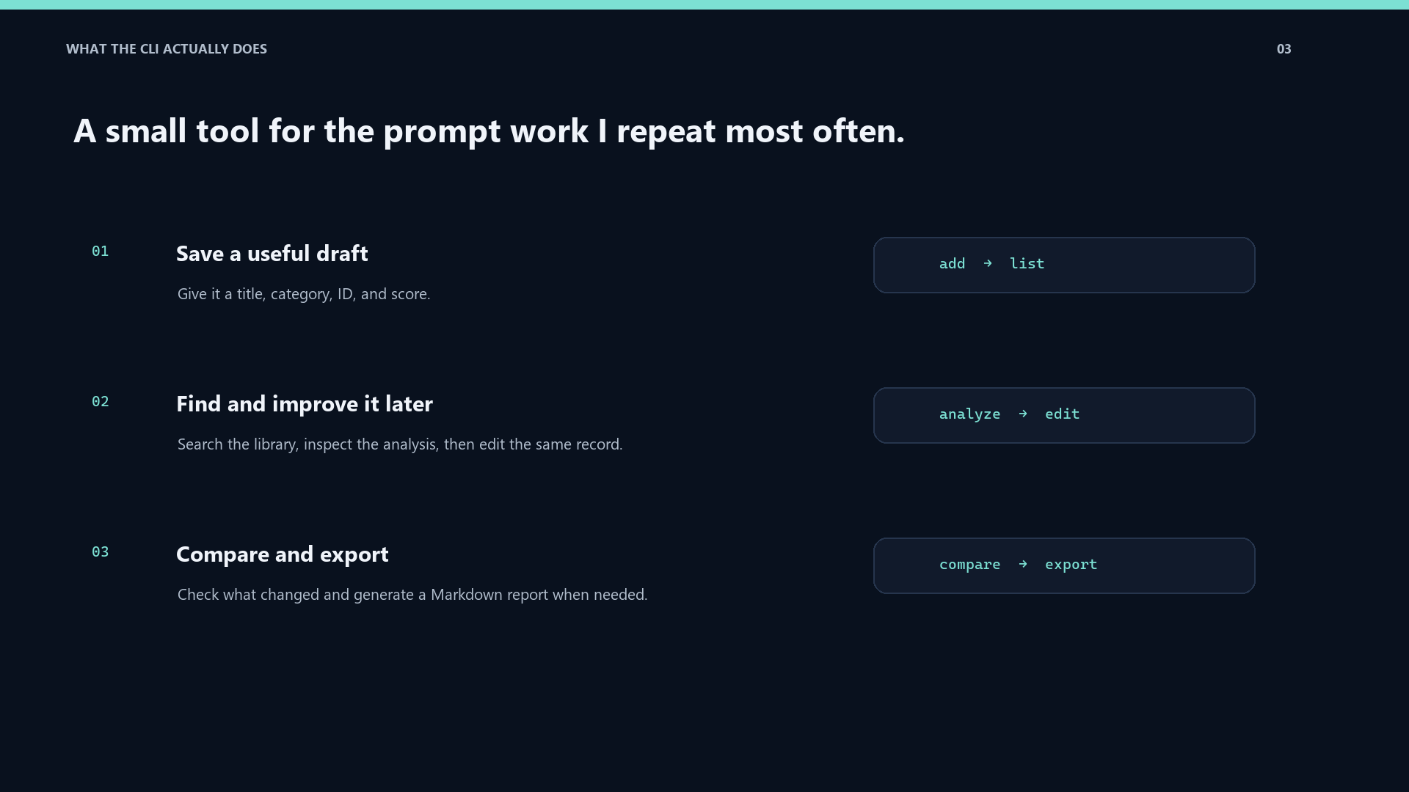

Slide 4
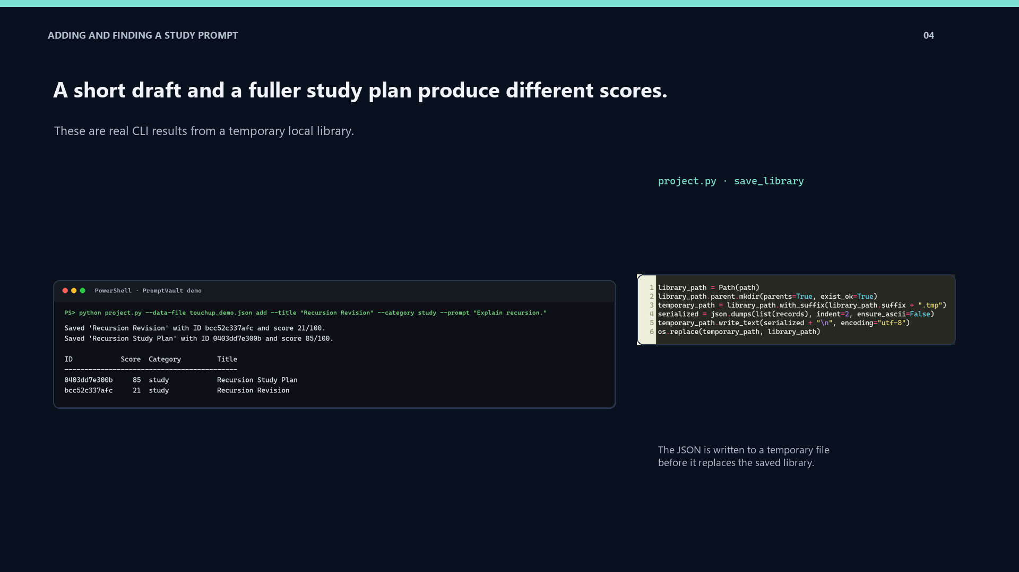



Slide 5
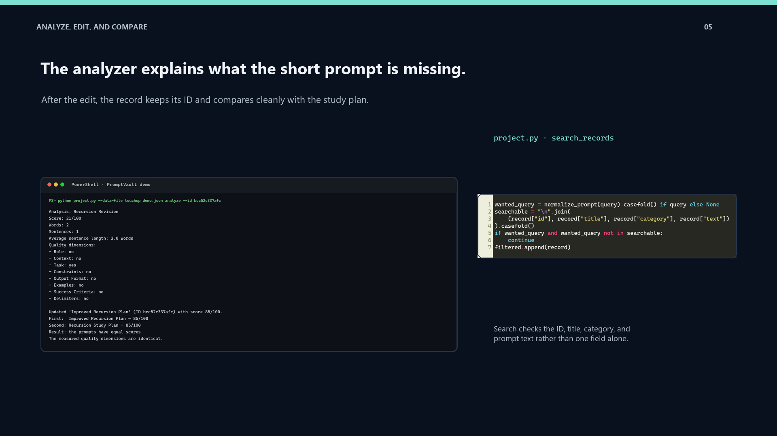
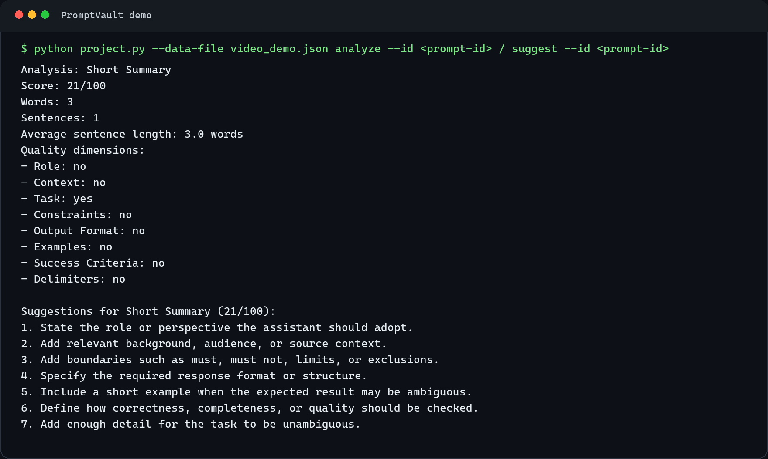
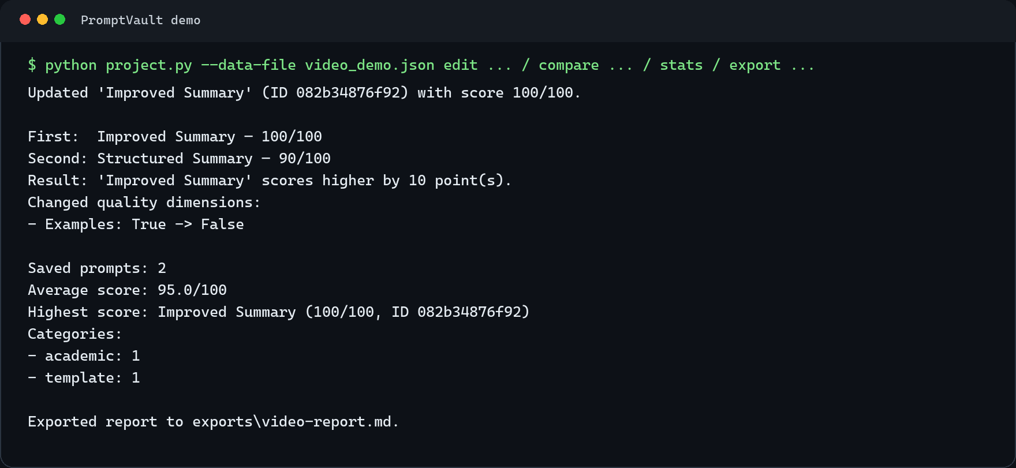


Slide 6
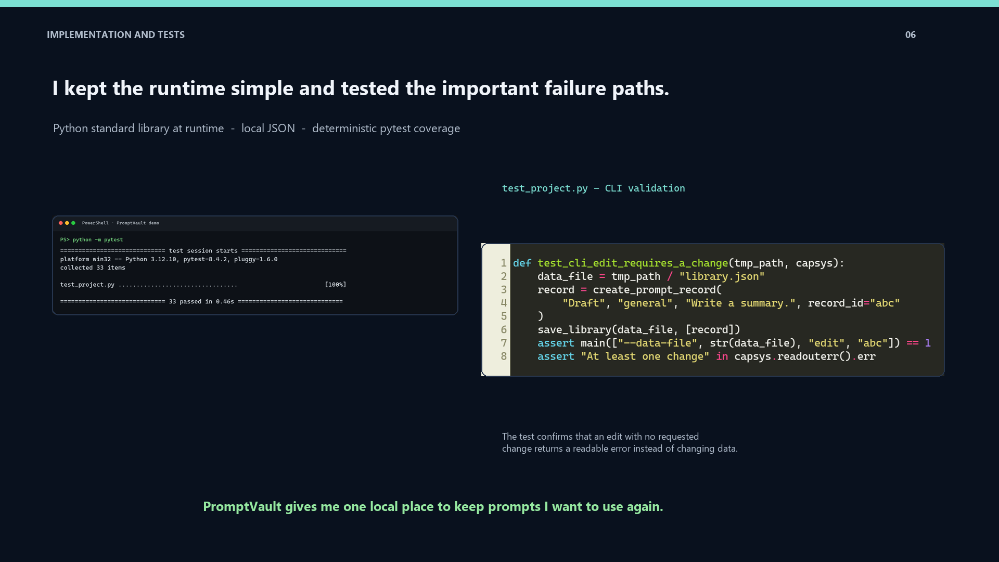

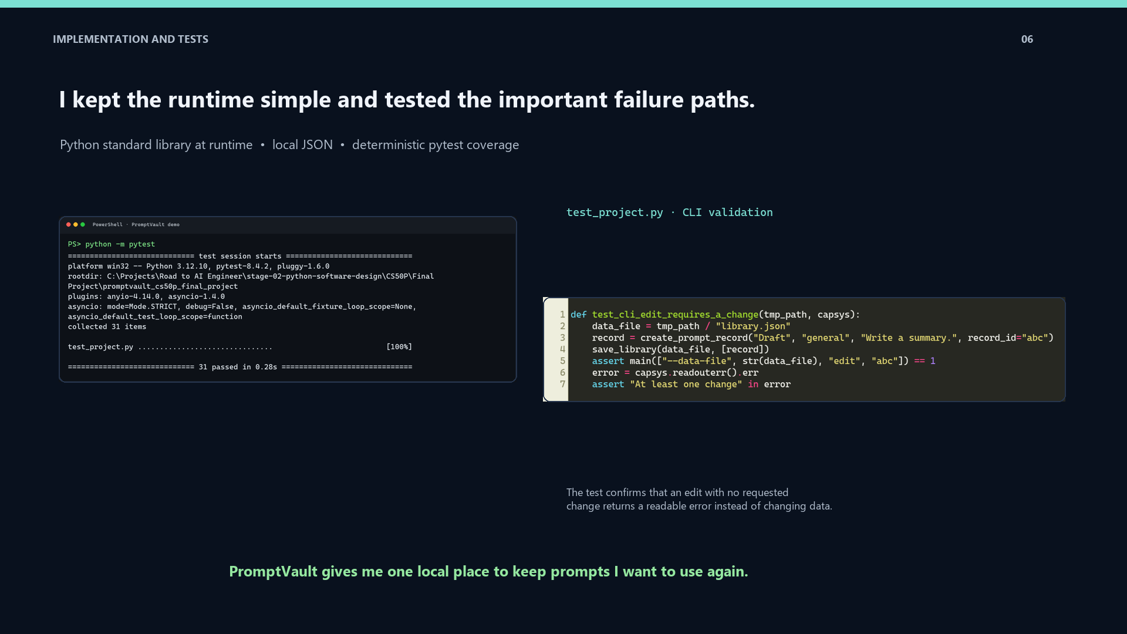
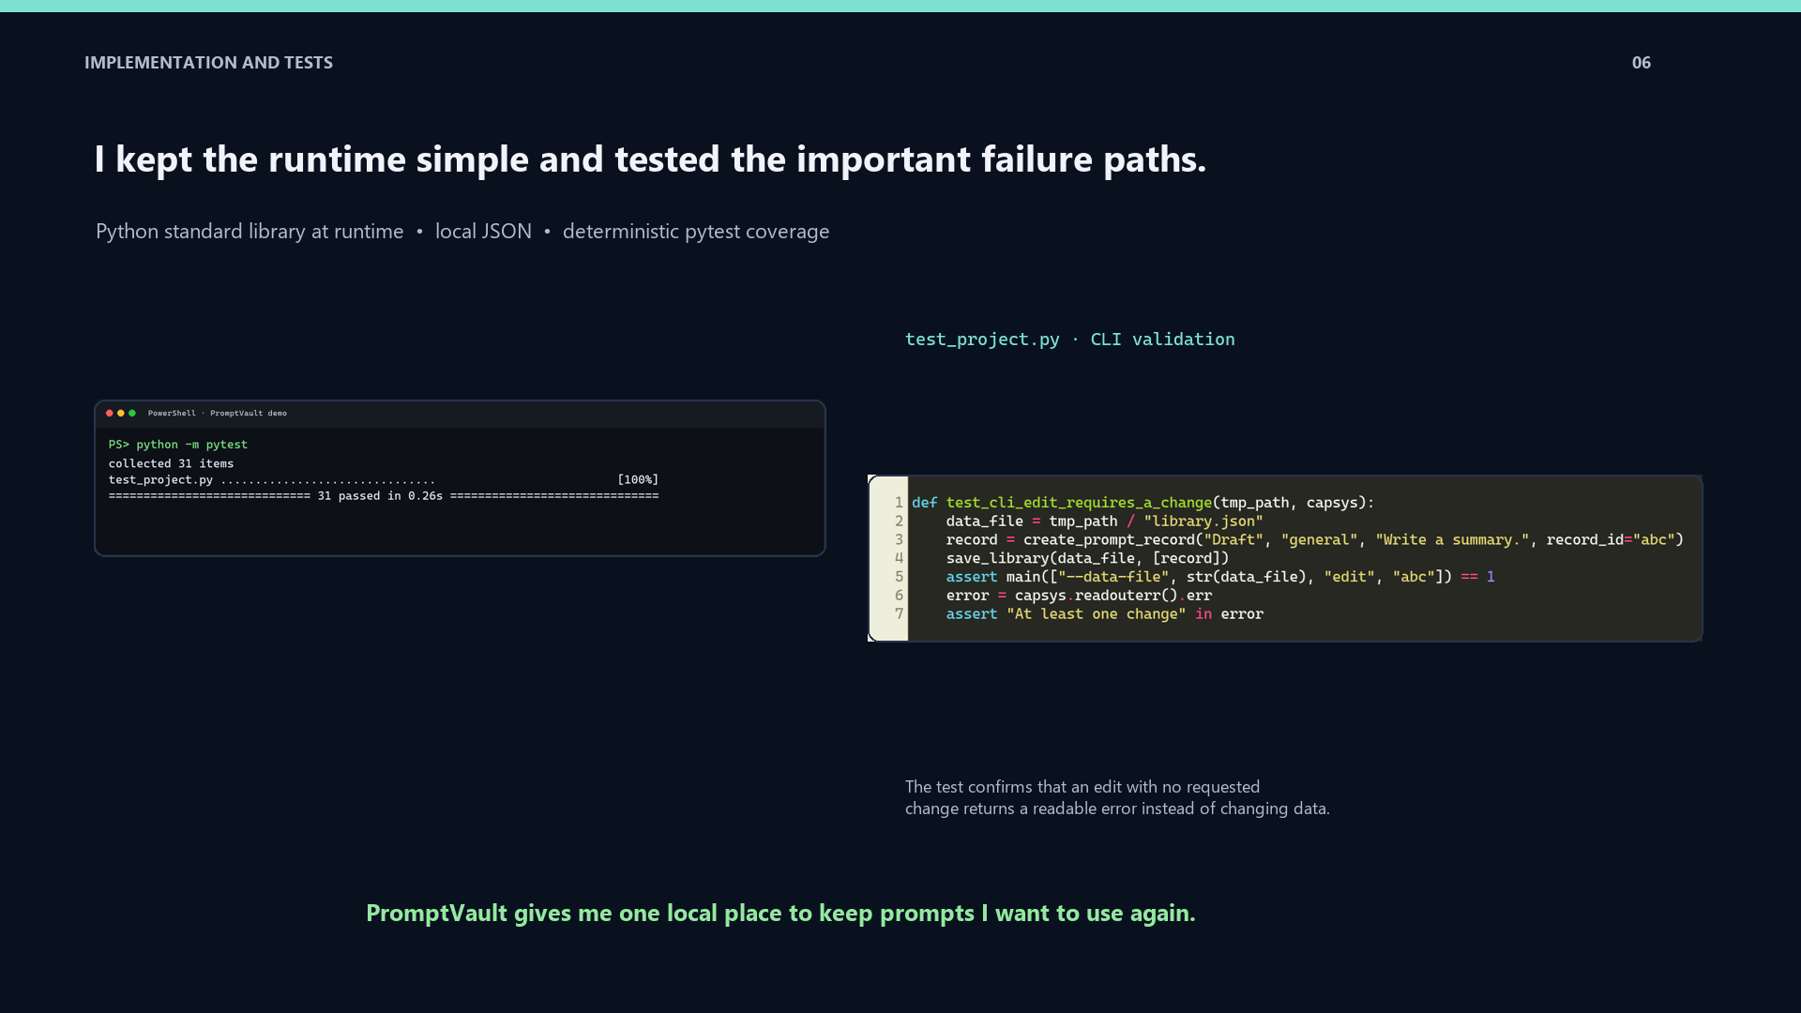

Slide 7
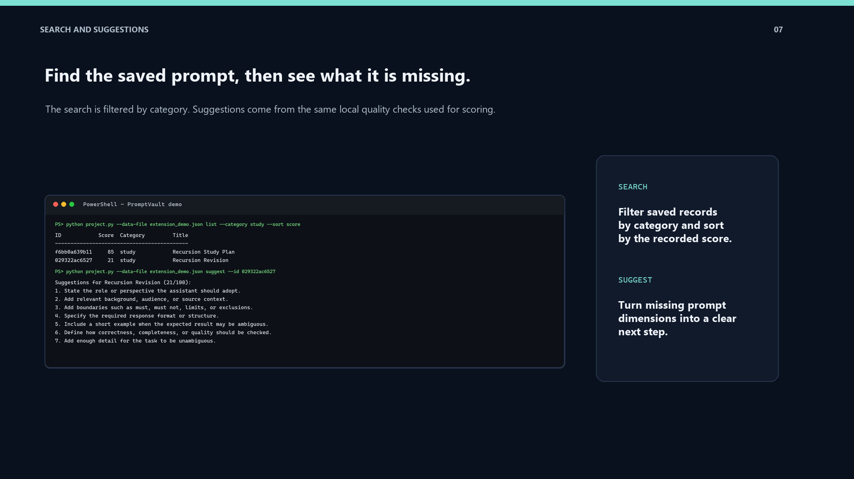

Slide 8
